Slide 1

ACADEMIA-GPT:
SMART TUTORING
AND
QUESTION GENERATION
Presented By:
Team 2 Yassin Khudari, Jainam Shah, Daniel DeCosmo,
Nikhila Rao Lakku, Stephanie De Vasantha, & Sandra Ann Mathew

Slide 2
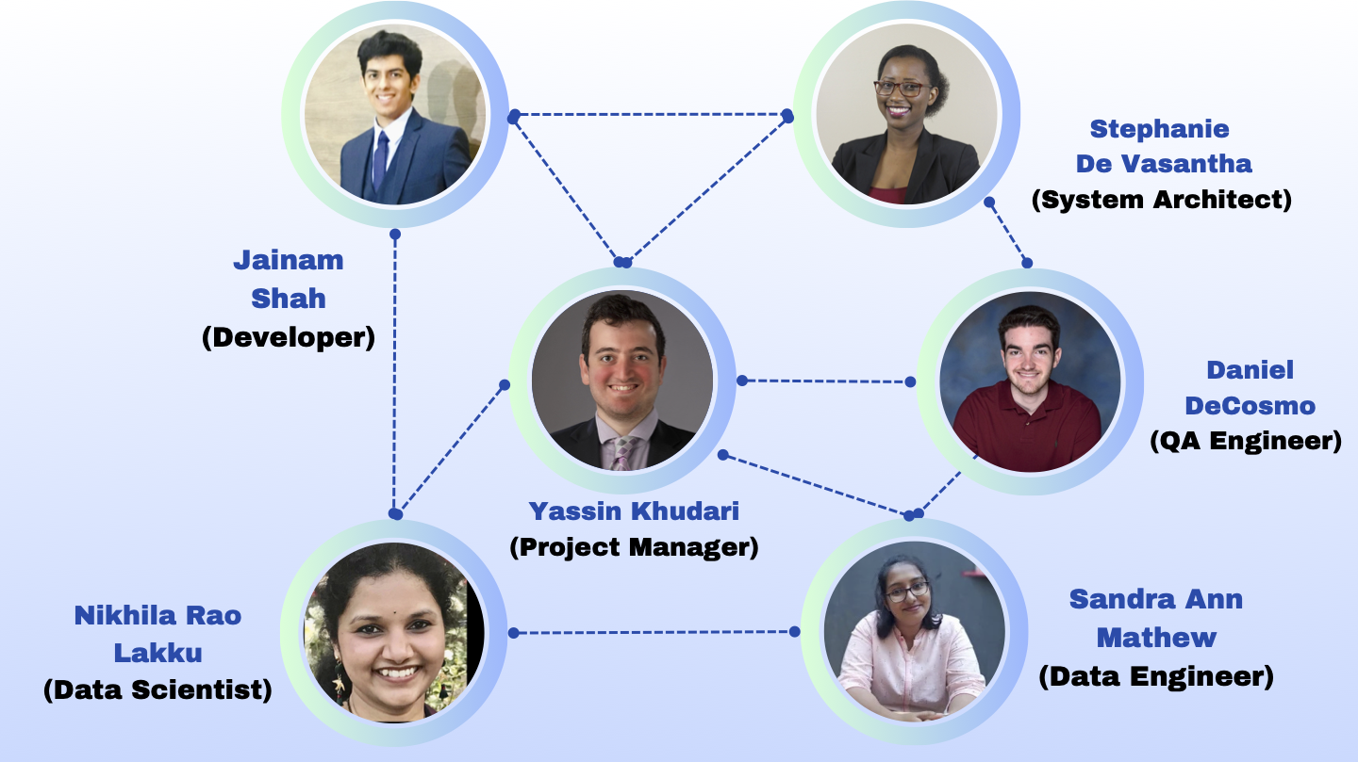
TEAM MEMBERS

Slide 3
SUMMARY
PURPOSE
Academia-GPT implements innovative strategies to enhance educational experience for both instructors and college students.
For college students: Provides tutoring services
For instructors:
Generates testing questions with different level of difficulty

Slide 4
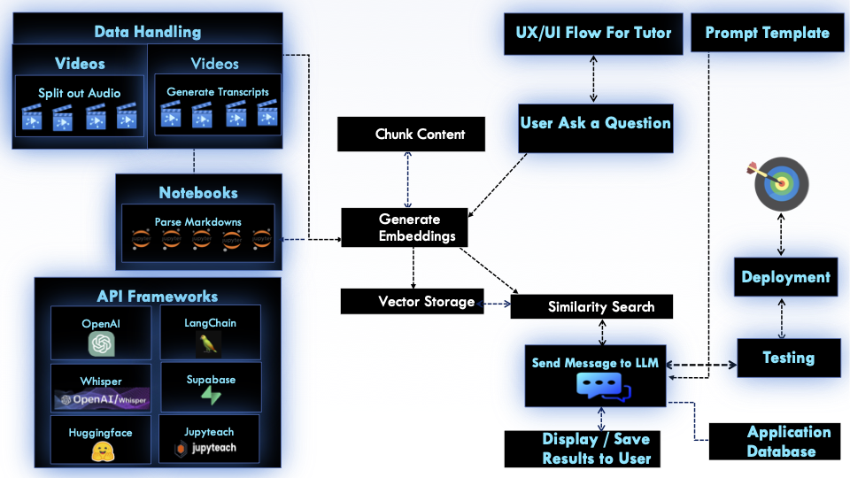
HIGH LEVEL ARCHITECTURE

Slide 5

PROJECT DEVELOPMENT MODEL
Scrum Methodology
Allows for regular and continuous implementations
Suitable for AI as it allows for adaptation and flexibility throughout all stages of the project
Tools: Jira
Popular tool for Scrum project management

Slide 6
SYSTEM REQUIREMENTS
Functional
(common)
Store history of all chats and questions in database
Allow user feedback (for tutor, this would be from students and for question generator this is from instructors)
Provide reference for all generated content
Report any potential issues to both user and system administrator
AI Tutor:
Explain concepts in a selected tone
Generate code examples for a concept
Question Generator:
Able to generate all types of questions
Instructor can edit proposed questions
Create answers alongside questions for automated grading
Questions should have targeted difficulty
Functional

Slide 7
SYSTEM REQUIREMENTS
Response time and resource utilization must be consistent to ensure reliability and high performance
Both systems should be able to handle unexpected increased workloads
Adherence to data protection measures to prevent unauthorized access, data breaches, and misuse
Non
Functional

Slide 8
SYSTEM REQUIREMENTS
Agile-Scrum Methodology:
Following the Agile-Scrum methodology, which includes sprint planning, sprint reviews, and retrospectives. Sprint Duration: Define sprint durations, typically 1 week each for each sprint, during which specific features or tasks will be completed.
Process Constraint

Slide 9
SYSTEM REQUIREMENTS
Common in Tutoring and Question Generator:
Integration: Proper integration of the AI tutor and question generator into the Jupyteach LMS is necessary for allowing users and instructors to use it effectively.
Language and Technology Stack: This project is going to be developed using Python as the primary programming language. Considering the language dependency, it is the only language that could be integrated with the OpenAI API, Langchain, Supabase, and will be deployed on JupyterHub.
Question Generator
Output in the format of JSON object and hence using the PydanticOutput parser.
Design Constraints

Slide 10

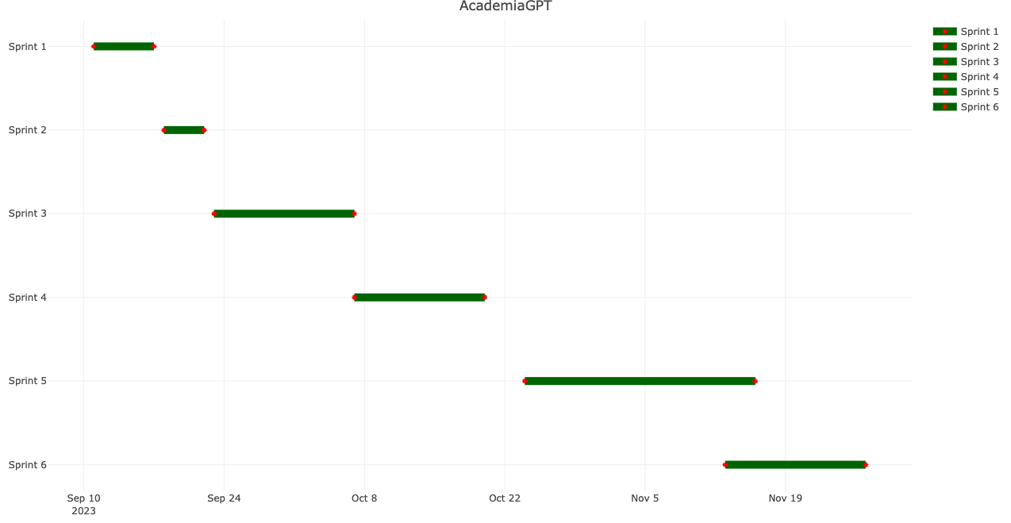
GANTT CHART

Slide 11
PROJECT PLAN
Sprint 1 | Project Management | Assigned To | Start Date | End Date | Days | Complete % | Work Days
1.1 | Introduction | Stephanie De Vasantha | 9/11/2023 | 9/14/2023 | 4 | 100% | 3
1.2 | Scope of Work | Jainam Shah | 9/11/2023 | 9/14/2023 | 4 | 100% | 3
1.3 | Timeline | Sandra Ann Mathew | 9/11/2023 | 9/14/2023 | 4 | 100% | 3
1.4 | Considered Models | Yassin Khudari | 9/15/2023 | 9/17/2023 | 3 | 100% | 2
1.4.1 | Advantages/Disadvantages of Models | Daniel DeCosmo | 9/15/2023 | 9/17/2023 | 3 | 100% | 2
1.5 | Implementation | Nikhila Rao Lakku | 9/15/2023 | 9/17/2023 | 3 | 100% | 2
Sprint 2 | Project Details | Assigned To | Start Date | End Date | Days | Complete % | Work Days
2.1 | Gantt Chart | Yassin Khudari | 9/18/2023 | 9/19/2023 | 2 | 100% | 2
2.2 | Project Activity | Nikhila Rao Lakku | 9/18/2023 | 9/19/2023 | 2 | 100% | 2
2.3 | Critical Path Method | Sandra Ann Mathew | 9/18/2023 | 9/19/2023 | 2 | 100% | 2
2.4 | Risk Analysis | Jainam Shah | 9/20/2023 | 9/22/2023 | 3 | 100% | 2
2.5 | Exposure | Daniel DeCosmo | 9/20/2023 | 9/22/2023 | 3 | 100% | 2
2.6 | System Requirements | Stephanie De Vasantha | 9/20/2023 | 9/22/2023 | 3 | 100% | 2

Slide 12
Sprint 3 | Data Preparation | Assigned To | Start Date | End Date | Days | Complete % | Work Days
3.1 | Splitting Videos | Nikhila Rao Lakku | 9/23/2023 | 9/26/2023 | 4 | 100% | 4
3.2 | Converting Audios to Transcripts | Sandra Ann Mathew | 9/27/2023 | 9/29/2023 | 3 | 100% | 3
3.3 | System Storage | Jainam Shah & Yassin Khudari | 9/23/2023 | 10/02/2023 | 10 | 100% | 10
3.4 | Parsing Jupyter Notebooks | Daniel DeCosmo & Stephanie De Vasantha | 9/23/2023 | 10/07/2023 | 15 | 100% | 15
Sprint 4 | Data Transformation | Assigned To | Start Date | End Date | Days | Complete % | Work Days
4.1 | Chunking Content | Sandra Ann Mathew & Nikhila Rao Lakku | 10/08/2023 | 10/12/2023 | 5 | 100% | 5
4.2 | Generate Embedding | Yassin Khudari & Daniel DeCosmo | 10/12/2023 | 10/20/2023 | 9 | 100% | 9
4.3 | Develop Pipelines into Storage Vector | Jainam Shah & Stephanie De Vasantha | 10/19/2023 | 10/23/2023 | 5 | 100% | 5

Slide 13
Sprint 5 | RAG and Output Generation | Assigned To | Start Date | End Date | Days | Complete % | Work Days
5.1 | Retrievals for AI Tutor | Nikhila Rao Lakku & Jainam Shah | 10/24/2023 | 11/29/2023 | 6 | 100% | 6
5.2 | Output Generation for AI Tutor | Yassin Khudari | 10/30/2023 | 11/04/2023 | 5 | 100% | 5
5.3 | Retrievals for Question Generator | Daniel DeCosmo & Sandra Ann Mathew | 10/24/2023 | 11/04/2023 | 11 | 100% | 11
5.4 | Output Generation for Question Generator | Stephanie De Vasantha | 10/05/2023 | 11/16/2023 | 12 | 100% | 12
Sprint 6 | Deployment | Assigned To | Start Date | End Date | Days | Complete % | Work Days
6.1 | Refine Prompts | Yassin Khudari & Nikhila Rao Lakku | 11/17/2023 | 11/19/2023 | 3 | 100% | 2
6.2 | Create API Server | Jainam Shah | 11/17/2023 | 11/19/2023 | 3 | 100% | 3
6.3 | Integration and Deployment | All | 11/20/2023 | 11/24/2023 | 5 | 100% | 5
6.4 | Documentation | All | 11/25/2023 | 11/27/2023 | 3 | 100% | 3

Slide 14

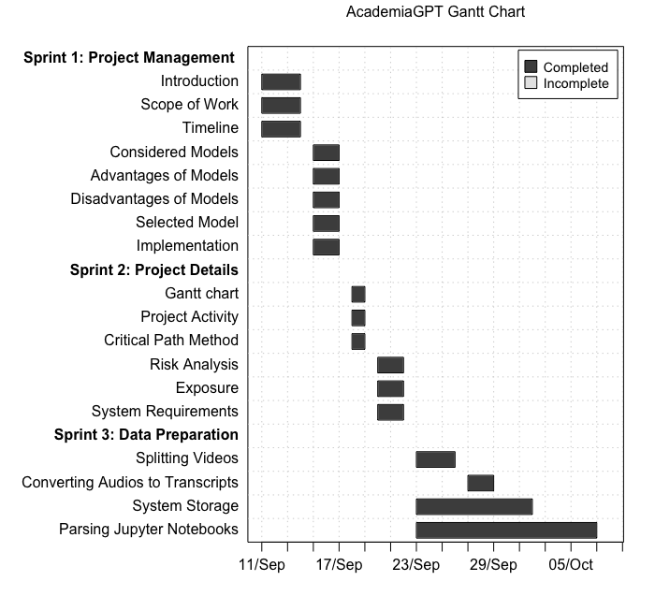

Slide 15
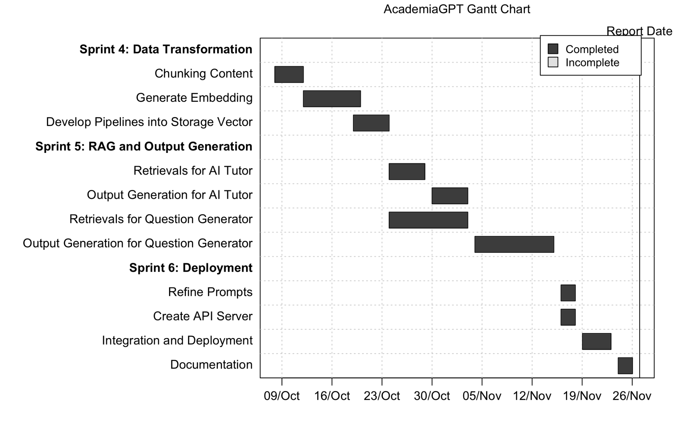

Slide 16
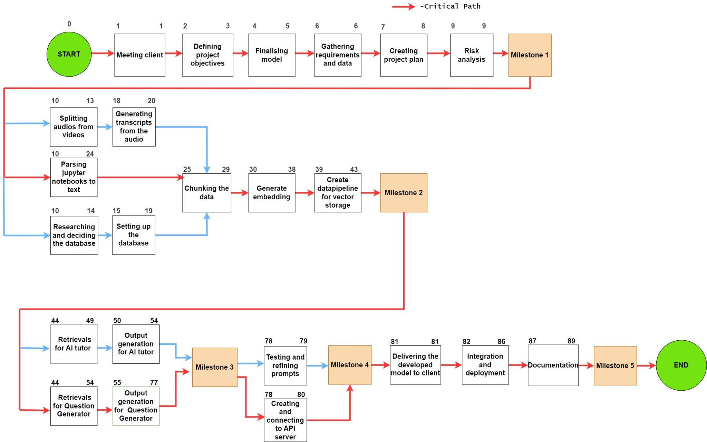
CRITICAL PATH

Slide 17
CONSIDERED RISKS
Technical
Research
Integration Bugs
Performance Issues
Management
Effort Estimation
Cost (Related to OpenAI API)
Organizational
Resource Acquisition
External
User Trust
Academic Integrity Concerns

Slide 18
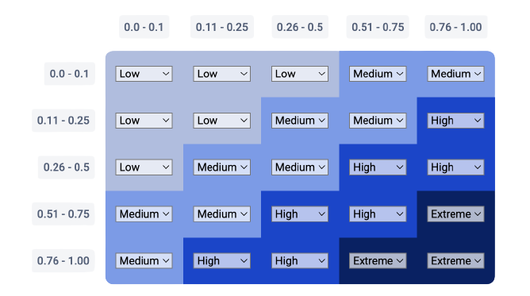
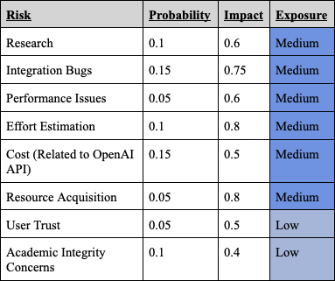
RISK EXPOSURE
Impact →
← Probability

Slide 19
MINIMUM VIABLE PRODUCT
Core API Server to ingest user questions, pass to AI tutor, and return responses.
Conversational interface allowing students to engage with AI tutor through chat.
Handling of common question topics and vocabulary within one course subject area.

Slide 20
FINAL CONTEMPLATION
Generating multiple questions at once for Question Generator.
Making Question Generator more conversational.
Refining the AI tutor based on user development and gather user feedback

Slide 21
MINIMUM VIABLE PRODUCT
Jupytutor Demo
JupyterHub - Question Generator
Academia-GPT YouTube video
Notes:
Yassin / Jainam (Demo)

Slide 22
QUESTIONS

Slide 23


